Slide 1
WEEK 6 ASSIGNMENT · AGENTIC AI · UTD
USA National Parks
RAG Assistant
A Conversational Travel Guide Powered by Local LLM
Presented by
GROUP Lion kings
Raji Sivani Murugesan
Naveenkumar Rameshbabu
Akhil Saravanan
63 Parks
100% Local
ChromaDB + Ollama
Streamlit UI
Error handling
Notes:
Hi everyone,before introducing the title, I'll walk you through a small scenario where you’re standing inside Yellowstone or Zion, trying to check trail information or park details — and suddenly you lose internet signal. That’s actually very common in many national parks.
To address this we built our USA National Parks RAG Assistant, a conversational travel guide powered completely by a local LLM.This acts as a one-stop place to get the information they need, instead of searching through multiple pages across the internet.
Our goal was simple: if someone asks any question about any of the 63 U.S. national parks, the assistant should respond with grounded information from our own park documents, not random internet knowledge.
So what’s special here is the 100% local setup: we use ChromaDB to store the knowledge base, Ollama to run both the embedding model and the LLM locally, and a Streamlit chat UI so it feels like a real assistant.
And our big promise is: no API keys, no internet calls, and answers should stay tied to the park content we indexed. In the next slide, I’ll quickly explain what our RAG pipeline does in this project, and then we’ll jump into a short demo.”

Slide 2
What is Retrieval-Augmented Generation?
R
A
G
Retrieval
Augmented
Generation
Search a knowledge base to find the most relevant pieces of information for the question asked.
Add the retrieved content as context to the question before passing it to the language model.
The language model reads the context and writes a grounded, accurate answer.
Why RAG Exists
What Our RAG Does
→ Language models have fixed training knowledge
→ RAG gives them access to YOUR specific documents
→ Every answer is grounded in real retrieved content
→ Not based on memorized training data
Knowledge base 63 US National Park documents (nps.gov)
User asks "Where is Zion?"
RAG retrieves Most relevant park chunks
LLM generates Answer grounded in those chunks
Notes:
“Instead of explaining RAG in theory, I’ll frame it as what our system is doing. Our knowledge base is 63 national park visitor guide documents which we got from the national park services website. When a user asks something like ‘Where is Zion?’ we don’t want the model to guess — we want it to look up the answer inside our park files first.
So our pipeline has three steps:
Retrieval: we search our ChromaDB vector store and pull the top relevant chunks from the park documents.
Augmented: we attach those retrieved chunks as context to the user question, so the model is forced to answer based on what we found.
Generation: our local LLM, gemma2:2b, reads that context and produces a helpful travel-style response.
The reason we built it this way is: LLMs have fixed training knowledge, but our park details are in our documents, so retrieval is what makes the answers project-specific. Now I’ll open the demo and run the first question live.”
“I’ll ask the first question now — and right before it returns the final answer, we’ll pause and continue with the architecture so you can see exactly how that answer is produced.”

Slide 3
System Architecture — How It All Connects
INDEXING · RUNS ONCE
📄
✂️
🔢
🗄️
▶
▶
▶
Documents
Chunker
nomic-embed-text
ChromaDB
63 park .txt files
150 words + 15 overlap
768-dim vectors
Saved to disk
QUERYING · EVERY QUESTION
💬
🔢
🎯
🤖
✅
▶
▶
▶
▶
User Question
nomic-embed-text
ChromaDB Search
gemma2:2b
Answer
+ chat history
Same model!
Top chunks
Local LLM
Grounded response
★ Same embedding model used on BOTH sides — documents and questions must share the same vector space.
Notes:
"So what you're looking at here is the full architecture of our RAG system. I want you to notice something important first — there are two separate phases, and understanding this separation is the key to understanding how RAG works.
The top row is the Indexing phase. This runs only once — the very first time we set up the system. We take all 63 national park documents, process them, convert them into vectors, and save everything permanently to disk. After this phase is done, the documents never need to be processed again. The knowledge is locked in.
The bottom row is the Querying phase. This runs every single time a user asks a question. The user types something into the chat, we convert that question into a vector using the exact same model, we search the database for the most similar content, and we hand those results to the language model to write the final answer.
Now here's the most important callout at the bottom of this slide — same embedding model on both sides. The documents and the questions must live in the same mathematical space. If you use different models, it's like translating documents into French and searching for them in Spanish — the numbers are incompatible and retrieval breaks entirely.
Every box in this diagram is a separate technical component, and we're going to zoom into each one. Let's start with the very first step — chunking."

Slide 4
Step 1 — Chunking: Breaking Documents Into Pieces
Why Chunking?
· Splits documents into smaller pieces
· Retrieves only relevant sections
· 63 parks, 150-word chunks
514 chunks stored total
Chunk 0
Chunk 1
Chunk 2
Chunk 3
words 0–150
words 135–285
words 270–420
405–555
← 15-word overlap →
✓ USED
Fixed Size
Fixed Size + Overlap
Sentence / Paragraph
Semantic
Cut every N words — simple and fast but can split sentences in half
Neighbouring chunks share words — prevents losing context at boundaries
Splits at natural language boundaries — chunk sizes vary wildly
AI detects meaning shifts — most intelligent but very slow on CPU
Our config: chunk_size = 150 words · chunk_overlap = 15 words ·
Notes:
Think about it this way — imagine you have a 1,000 page encyclopedia and someone asks you a question. You wouldn't hand them the entire encyclopedia. You'd find the right page and give them just that. Chunking is exactly that idea applied to AI.
Our 63 park documents average around 1,000 words each. A language model can only read about 2,000 words at once in its context window. And we certainly cannot send the text of all 63 parks with every single question — that would be millions of words. So we break each document into smaller, searchable pieces called chunks.
Now, there are four main ways to do this. Fixed Size is the simplest — just cut every N words. Fast, but it can slice a sentence right in the middle, losing meaning. Sentence and Paragraph splitting respects natural language boundaries, but the chunk sizes become unpredictable. Semantic chunking uses AI to detect where the meaning shifts — the most intelligent approach, but far too slow for our CPU-only machine.
We chose Fixed Size with Overlap — and here's why that overlap matters. Look at the diagram on the right. Chunk 0 covers words 0 to 200. Chunk 1 doesn't start at 201 — it starts at 180. Those 20 shared words are the overlap. This means that if a key piece of information falls right at the boundary between two chunks — like a sentence that starts at word 195 — it still appears fully in the next chunk. We never lose context at the edges.
Our final configuration is chunk size of 200 words with 20 words of overlap, giving us roughly 5 to 6 chunks per park document and around 380 chunks total across the entire knowledge base."

Slide 5
Step 2 — Embeddings: Teaching the Computer to Understand Meaning
What is an Embedding?
Keyword vs Semantic Search
Text converted into a list of numbers
that represents its MEANING — not just its words.
Keyword
"geyser" → only finds docs with that exact word
"Yellowstone has geysers"
→
[0.23, -0.87, 0.45 ...]
≈ similar ✓
Semantic
"Old Faithful erupts daily"
→
[0.21, -0.91, 0.43 ...]
≈ similar ✓
"geyser" → also finds "hydrothermal", "hot spring", "Old Faithful"
"Car needs an oil change"
→
[0.89, 0.34, -0.67 ...]
≠ different
⚠ Critical Rule
The SAME embedding model must be used to index documents AND embed user questions.
Using different models creates incompatible vector spaces — retrieval breaks completely.
Our Model
Size
Output
Runs
Speed
nomic-embed-text (via Ollama)
274 MB
~768 numbers per chunk
100% locally — no internet
~0.5 sec per chunk
Notes:
Embeddings are the heart of why RAG works. Instead of matching exact words, we convert text to numbers that represent meaning. nomic-embed-text was chosen because it's the best performing local embedding model that runs on CPU, it's only 274MB, and critically — it's the same model we use on both sides. When we index a document AND when we embed a user question, we use the exact same model. This is non-negotiable — using different models would make the number spaces incompatible and retrieval would completely break.

Slide 6
Step 3 — ChromaDB: Storing and Searching Vectors
ChromaDB is a vector database — built specifically to store embeddings and find the most similar ones to any query in milliseconds.
Feature
Normal Database (SQL)
ChromaDB
Stores
Text, numbers, dates
Vectors (lists of numbers)
Searches by
Exact match (WHERE name='x')
Meaning similarity (cosine)
Speed
Fast for exact lookup
< 1 second for 514 vectors
Use case
Users, orders, records
AI, semantic search, RAG
~514
< 1s
Cosine
Local
Vectors Stored
Search Speed
Similarity Metric
chroma_db/ folder
Notes:
ChromaDB is our vector database. Instead of storing normal text like SQL, it stores embeddings — which are numerical representations of meaning.
We stored about 514 chunk vectors from all 63 parks. When a user asks a question, we convert it into a vector using the same embedding model, then ChromaDB compares it to all stored vectors using cosine similarity.
Cosine similarity measures how close two meanings are based on the angle between vectors. The top 3 most similar chunks are retrieved in under one second.
So basically, ChromaDB is our semantic search engine running completely locally.”

Slide 7
Step 4 — The Language Model: Generating the Answer
What the LLM Does
System Prompt Rules
→ Reads the retrieved chunks + user question
→ Follows our system prompt rules strictly
→ Writes a clear, human-readable answer
→ Answers ONLY from provided context
1. Answer ONLY from the provided context
2. Always mention which park you discuss
3. Say 'I don't have that info' if unsure
4. Keep answers concise and practical
Model
Size
Speed on CPU
Quality
Decision
llama3.2:3b
2.0 GB
Slow
Very Good
Too large for 8GB RAM
gemma2:2b
1.6 GB
Moderate
Good
✓ CHOSEN
qwen2:0.5b
352 MB
Fast
Basic
Poor instruction follow
Why gemma2:2b? Best quality-to-size ratio for 8GB RAM · Reliable instruction following · Runs fully locally via Ollama
System Prompt
+ Chat History
+ Context Chunks
+ User Question
→ gemma2:2b
→ Answer
Notes:
After retrieval, we pass the top chunks to our language model, gemma2:2b.
We tested three models, and gemma2 gave the best balance between size, speed, and quality for our 8GB RAM system.
The model follows strict system rules: it must answer only from the provided context, mention the park name, and say ‘I don’t know’ if the information isn’t available.
So ChromaDB finds the right information, and the LLM turns it into a clear, human-readable answer — all running locally through Ollama.”

Slide 8
Conversation Memory: Making It Feel Natural
Without Memory
With Memory ✓
User: Where is Yellowstone?
User: Where is Yellowstone?
AI: Yellowstone is in Wyoming...
AI: Yellowstone is in Wyoming...
User: What are the entry fees?
User: What are the entry fees?
AI: I don't know which park you mean ❌
AI: Entry fee for Yellowstone is $35 ✓
How It Works
The enrich_query() Fix
1. Rolling window of last 6 messages (3 exchanges)
2. History passed with every new LLM call
3. LLM understands pronouns and follow-ups
4. Older messages dropped to save RAM
Memory helps the LLM — but ChromaDB
only reads the current question.
Solution: inject recent history INTO the search query so ChromaDB finds the right document for follow-up questions too.
Notes:
This slide shows why conversation memory is important in AI systems.
On the left side, we see what happens without memory. The user asks where Yellowstone is, and the AI answers correctly. But when the user asks a follow-up question about entry fees, the AI cannot understand the context because it doesn’t remember the previous question. So it responds saying it doesn’t know which park the user means.
On the right side, we see the same conversation with memory enabled. Here, the system remembers that the user was talking about Yellowstone, so it can correctly answer the follow-up question about the entry fee. This makes the conversation feel more natural and human-like.
To do this, the system keeps a rolling window of the last six messages.These messages are sent along with the new question so the model understands the context and references.
Older messages are dropped over time to save memory and computation.
Finally, in RAG systems, databases like ChromaDB usually see only the current query. So a function like enrich_query() adds recent conversation history to the search query, helping retrieve the correct documents for follow-up questions.

Slide 9
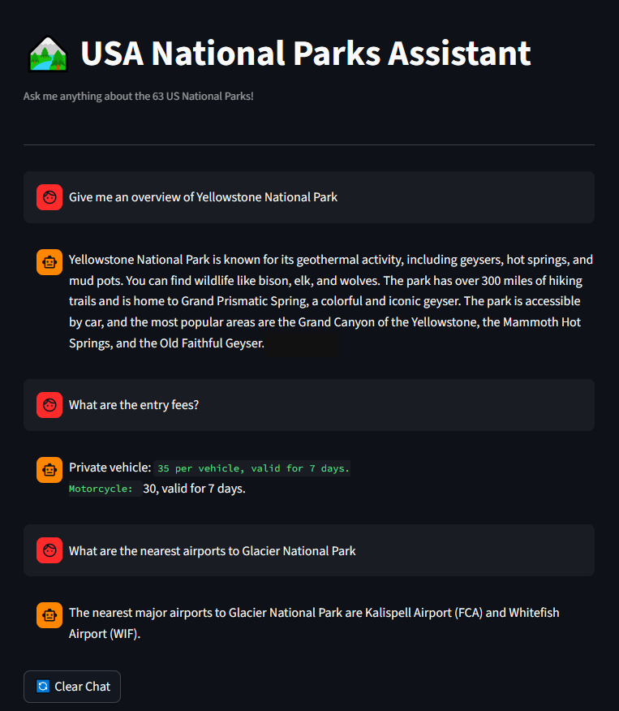
🏞️Demo🏞️
Notes:
We've already asked a few qns and pasted those here.
In the first example, we asked for an overview of Yellowstone National Park, and the assistant returns key information about the park.
Next, we asked a follow-up question about entry fees. Because the system keeps conversation context, it understands that we are still referring to Yellowstone and gives the correct answer.
In the final example, we asked about the nearest airports to Glacier National Park, and the assistant retrieves that information from the Glacier park document.
The key idea here is that the system retrieves the right park information and can handle follow-up questions, making the interaction feel like a natural conversation.
You can also see the conversation history in the interface. In our system, we keep the last six questions and responses in memory to maintain context while keeping the system efficient.

Slide 10
Summary & Future Work
What We Built
Future Improvements
✓ Fully local RAG — no internet, no API keys
✓ 63 US National Parks knowledge base
✓ Semantic search: ChromaDB + nomic-embed-text
✓ Local LLM: gemma2:2b via Ollama
✓ Multi-turn conversation memory
✓ Streamlit web chat interface
✓ Evaluation: Precision, Recall, Faithfulness, Latency
→ GPU deployment → 8-10 sec vs 3-5 min
→ PDF and web scraping for richer documents
→ Upgrade to llama3.1:8b on better hardware
→ Source citations with page-level references
→ Expand to all US state parks (1000s of docs)
→ Re-ranking layer for better precision
Architecture is modular — swap the LLM, embeddings, or documents by changing one line in CONFIG.
BUAN 6V99 Agentic AI · University of Texas at Dallas · Week 6 Assignment
Notes:
To conclude, our system works end-to-end. Park documents are embedded and stored in ChromaDB, relevant chunks are retrieved for each query, and LLM generates the response through the chat interface with conversation memory.
There are a few practical limitations. Since we built this on our personal laptops, everything runs on CPU, so responses can be slower compared to cloud systems with GPUs. With GPU or cloud resources, the same system could respond much faster.
Our assistant already works well with the park documents we indexed. In the future, we can improve it by adding more sources like park PDFs, official websites, or guidebooks to make the knowledge base richer.
We are also planning on improving the retrieval quality for better chunking or reranking methods.
The important point is that these are not problems with the architecture itself — they are mainly resource and scale limits. Our architecture is modular and flexible, we can easily swap the LLM, embedding model, or even the document collection simply by changing one line in the configuration. We believe our system can easily expand into a more powerful travel assistant.

